Slide 1
Constraint
Satisfaction Problems
Must be
Hot&Sour
Soup
No
Peanuts
Chicken
Dish
Appetizer
Total Cost
< $30
Pork
Dish
No
Peanuts
Vegetable
Not Both
Spicy
Seafood
Rice
Not
Chow Mein
Constraint
Network
1

Slide 2
Formal
Definition
of
CSP
• A constraint satisfaction problem (CSP) is a triple (V, D, C) where
– V is a set of variables X₁, ... , X_{n}.
– D is the union of a set of domain sets D₁,...,D_{n}, where D_{i} is the domain of possible
values for variable X_{i}.
– C is a set of constraints on the values of the variables, which can be pairwise (simplest and most common) or k at a time.
2

Slide 3
CSPs vs. Standard Search Problems
•
Standard search problem:
- state is a "black box“ - any data structure that supports successor function, heuristic function, and goal test
CSP:
- state is defined by variables X_{i} with values from domain
- goal test is a set of constraints specifying allowable combinations of values for subsets of variables
•
^{D}_{i}
•
Simple example of a formal representation language
•
Allows useful general-purpose algorithms with more
power than standard search algorithms
3

Slide 4
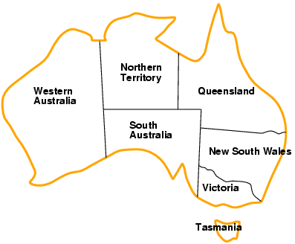
Example:
Map-Coloring
•
•
•
•
Variables WA, NT, Q, NSW,
V, SA, T
^{Domains D}_{i} ^{= {red,green,blue}}
Constraints: adjacent regions must have different colors
e.g., WA ≠ NT, or (WA,NT) in {(red,green),(red,blue),(green,red), (green,blue),(blue,red),(blue,green)}
4

Slide 5
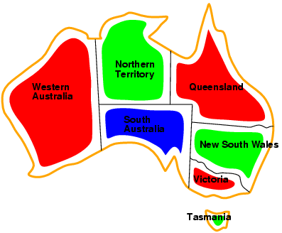
Example:
Map-Coloring
•
Solutions are complete and consistent
assignments, e.g., WA = red, NT = green,Q
=
red,NSW = green,V = red,SA = blue,T = green
5

Slide 6
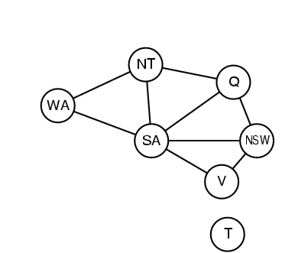
Constraint
graph
•
•
Binary CSP: each constraint relates two variables
Constraint graph:
constraints
nodes
are
variables,
arcs
are
6

Slide 7
Varieties
of
constraints
•
Unary constraints involve a single
variable,
- e.g.,
SA ≠ green
•
Binary
- e.g.,
constraints involve pairs of
value(SA) ≠ value(WA)
variables,
•
Higher-order constraints involve 3
variables,
or more
- e.g., cryptarithmetic column constraints
7

Slide 8
Real-world
Assignment problems
CSPs
•
- e.g., who teaches what class
Timetabling problems
- e.g., which class is offered when
Transportation scheduling Factory scheduling
•
and where?
•
•
Notice that many real-world real-valued variables
problems involve
10

Slide 9
What
Kinds
of
Algorithms
are
used
for
CSP?
• Backtracking Tree Search
• Tree Search with Forward Checking
• Tree Search with Discrete Relaxation (arc consistency, k-consistency)
• Many other variants
•
13

Slide 10
Backtracking
Tree
Search
• Variable assignments are commutative}, i.e.,
[ WA = red then NT = green ] same as [ NT = green then WA = red ]
• Only need to consider assignments to a single variable at each node.
• Depth-first search for CSPs with single-variable assignments is called
• Backtracking search is the basic uninformed algorithm for CSPs.
• Can solve n-queens for n ≈ 25.
backtracking
search.
14

Slide 11

Backtracking
Example
17

Slide 12
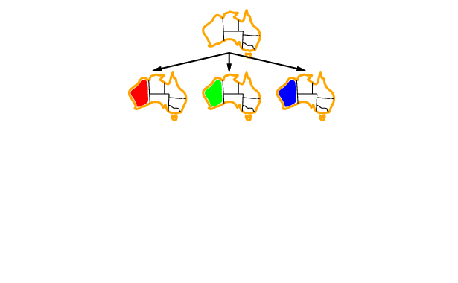
Backtracking
Example
18

Slide 13
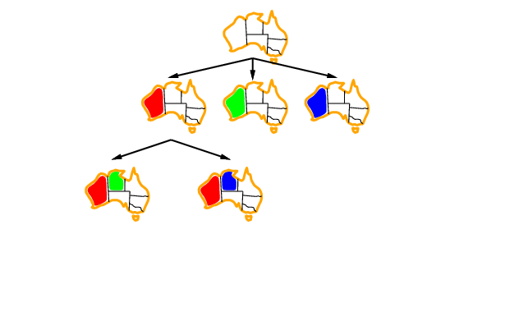
Backtracking
Example
19

Slide 14
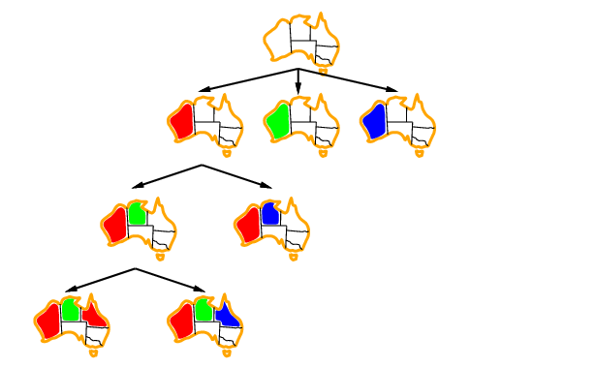
Backtracking
Example
20

Slide 15
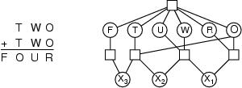
Example:
Cryptarithmetic
•
Variables:
{F, T, U, W, R, 0,
^{X}_{1,} ^{X}_{2,}
^{X}₃}
•
•
Domains: {0,1,2,3,4,5,6,7,8,9}
Constraints: Alldiff (F,T,U,W,R,0)
-
-
-
-
^{0 + 0 = R + 10 · X}₁^{D}
^{X}₁
X₂
X₃
+
+
=
^{W + W = U + 10 · X}₂^{D}
T + T = 0 + 10 · X₃
F, T i 0, F i 0
8

Slide 16
Improving Backtracking Efficiency
•
General-purpose methods can give huge
gains in speed:
-
-
-
Which variable should be assigned next?
In what order should its values be tried?
Can
we
detect
inevitable
failure
early?
21

Slide 17

Most
Constrained
Variable
•
Most constrained variable:
choose the variable with the fewest values
legal
•
a.k.a. minimum
heuristic
remaining values (MRV)
22

Slide 18

Most
Constraining
Variable
•
Tie-breaker among most constrained
variables
Most constraining variable:
•
-
choose the variable with
the
most
constraints
on
remaining
variables
23

Slide 19
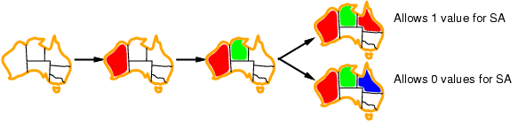
Least
Constraining
Value
•
Given a variable, choose the least
constraining value:
-
the one that rules out
the
fewest
values
in
the
remaining
variables
•
Combining
these heuristics
makes 1000
queens feasible
24

Slide 20
How do we incorporate forward checking into a backtracking depth-first search?
28

Slide 21
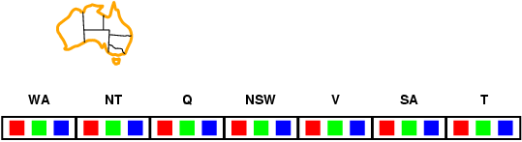
Book’s Forward Checking Example
•
Idea:
-
-
Keep track of remaining legal values
for unassigned variables
Terminate
search
when
any
variable
has
no
legal
values
29

Slide 22
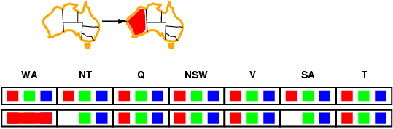
Forward
Checking
•
Idea:
-
-
Keep track of remaining legal values
for unassigned variables
Terminate
search
when
any
variable
has
no
legal
values
30

Slide 23
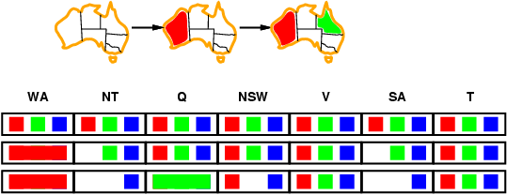
Forward
Checking
•
Idea:
-
-
Keep track of remaining legal values
for unassigned variables
Terminate
search
when
any
variable
has
no
legal
values
31

Slide 24
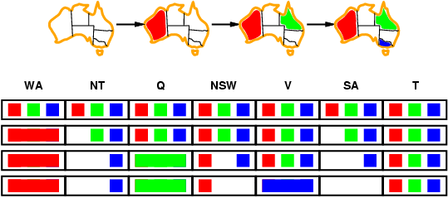
Forward
Checking
•
Idea:
-
-
Keep track of remaining legal values
for unassigned variables
Terminate
search
when
any
variable
has
no
legal
values
32

Slide 25
Constraint
Propagation
•
Forward checking propagates information from assigned
to unassigned variables, but
doesn't
provide
early
detection
for
all
failures:
•
•
NT and SA cannot both be
blue!
Constraint propagation repeatedly enforces constraints
locally
33

Slide 26
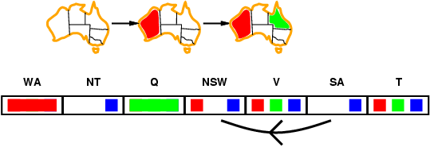
Arc
Consistency
•
•
Simplest form of propagation makes each arc consistent
X �Y is
consistent iff
for
every
value
x
of
X
there
is
some
allowed
value
y
of
Y
34

Slide 27
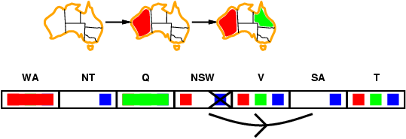
Arc
Consistency
•
•
Simplest form of propagation makes each arc consistent
X �Y is
consistent iff
for
every
value
x
of
X
there
is
some
allowed
value
y
of
Y
35

Slide 28
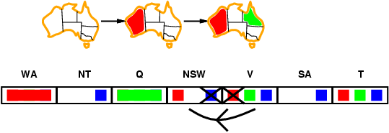
Arc
Consistency
•
•
Simplest form of propagation makes each arc consistent
X �Y is
consistent iff
value x of X there
for
every
is some allowed value y of Y
•
If X loses a value, neighbors of X need to be rechecked
36

Slide 29
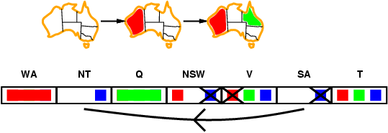
Arc
consistency
•
•
Simplest form of propagation makes each arc consistent
X �Y is
for every
consistent iff
value
x
of
X
there
is
some
allowed
value
y
of Y
es a value, neighbors of X need to be r
•
•
If X los
Arc consistency detects failure checking
echecked
forward
earlier
than
•
Can be run as a preprocessor or after each
assignment
37

Slide 30
Comparison of Methods
• Backtracking tree search is a blind search.
• Forward checking checks constraints between
current variable and all future ones.
the
• Arc consistency then checks constraints between
all
pairs
of
future
(unassigned)
variables.
• What is the complexity of a backtracking tree search?
• How do forward checking and arc consistency affect that?
40

